Slide 1



Railway Management System
PROJECT MEMBERS
JAIHARI D (19ITR028)
PROJECT GUIDE
Kabesh M 23ITR075
Megapranithaa M 23ITR096
Megavarshini M 23ITR097
Dr.Kamalam

Slide 2

Problem Statement: Railway Management System
The Railway Management System (RMS) is designed to help railway authorities manage trains efficiently. The system allows users to add, remove, and sort trains based on various attributes, ensuring a smooth operation and better resource management.
This Train Management System aims to enhance operational efficiency and ensure that train schedules are effectively managed and communicated.

Slide 3
Objectives
Design and implement a Railway Management System where the station
master (admin) can manage train records efficiently. The system should
support the addition, removal, searching, and sorting of train details such as
train number, train name, source, and destination. The station master can
interact with the system via a console-based interface.
3

Slide 4
Class Diagram
+ addTrain(): void +removeTrain(): void +searchTrain(): Train +manageReservations()
Train
Reservation
-trainNumber: int
-trainName: String
-source: String
-destination: String
-reservationID: int
-passengerName: String
-train:Train
-seatNumber:int
+ addTrain():void
+ removeTrain(): void
+ searchByNumber():Train
+serachByname():Train
+ sortTrainsByname():
+sortTrainsByNumber():
+reserveSeat(): void
+cancelReservation(): void
+checkWaitlist(): void

Slide 5
Software / Hardware Tools used
Java Development Kit (JDK) – (For compiling and running Java programs)
Integrated Development Environment (IDE) – (Develop, debug, and run Java projects with
applet support) Eclipse
Java Applet Viewer – (Run applets outside the browser)
5

Slide 6
Concepts Used :
1. Algorithms - Search Algorithms: Linear Search.
- Sorting Algorithms: Quick Sort
2. Java AWT (Abstract Window Toolkit) - Components: Label, TextField, Button, TextArea.
3. Applet Framework - Purpose: GUI and functionality are handled via Java Applet.
4. Event Handling - Implemented via ActionListener to manage button click events.

Slide 7
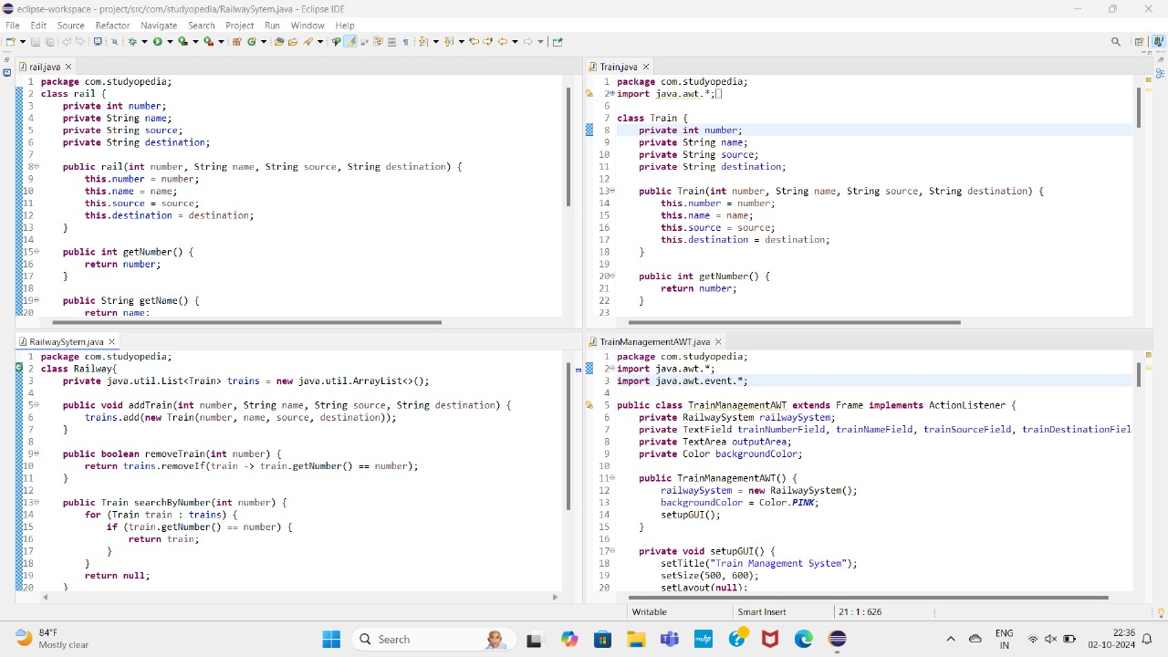
Coding
7

Slide 8
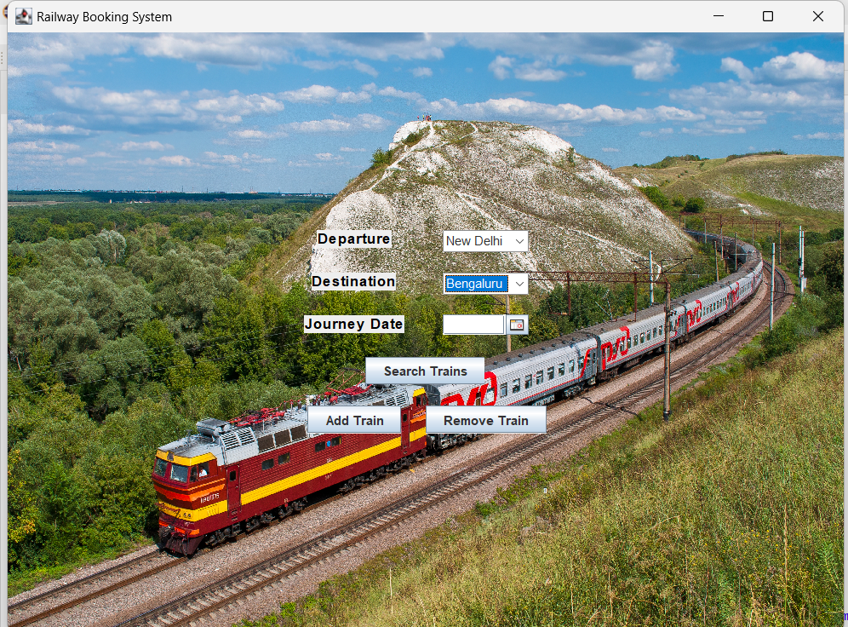
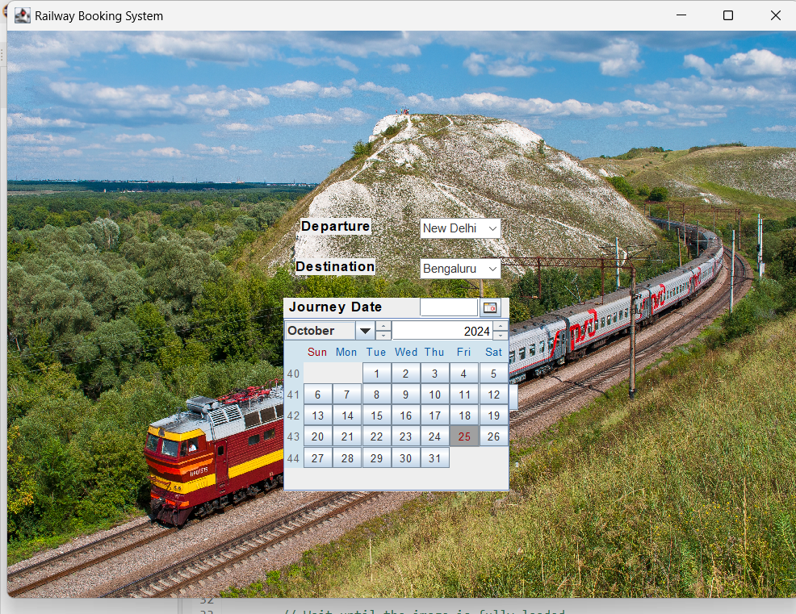
Output

Slide 9
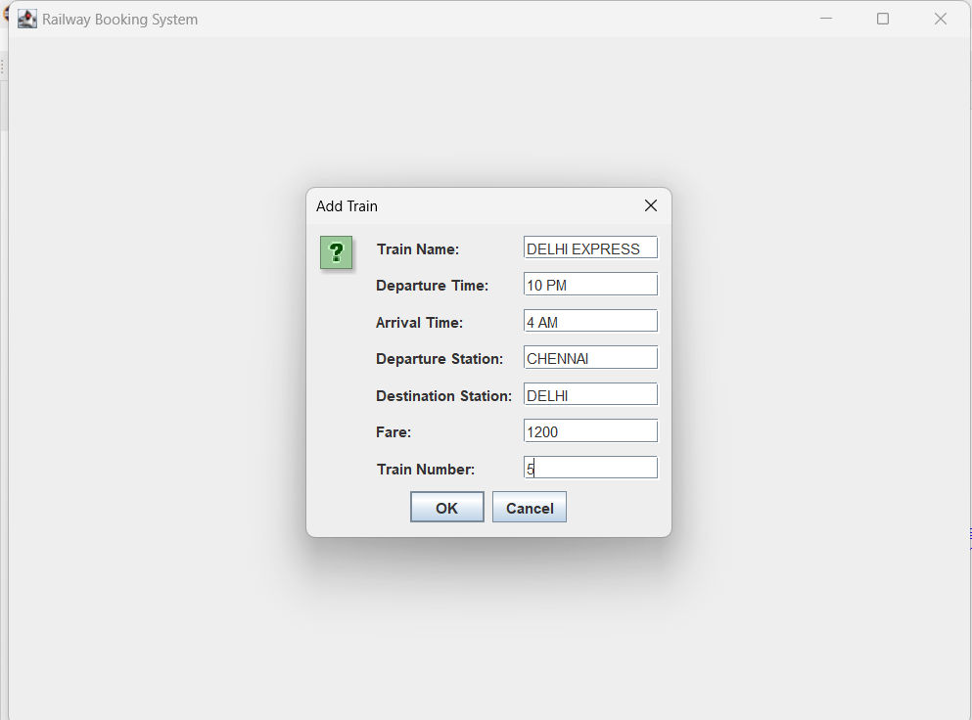
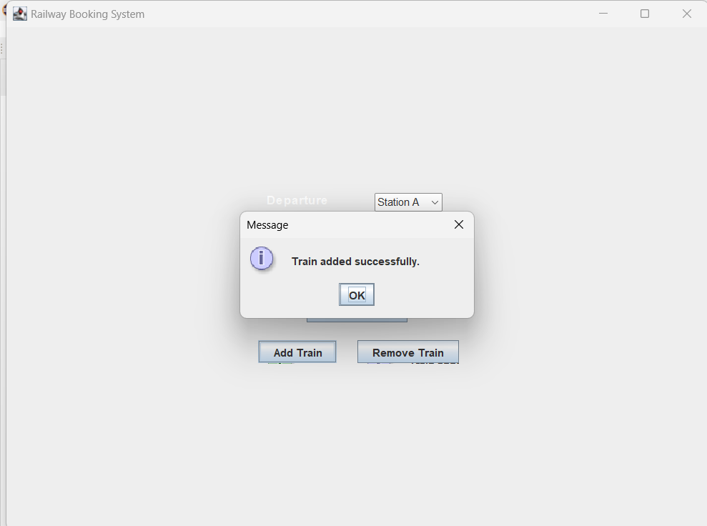

Slide 10
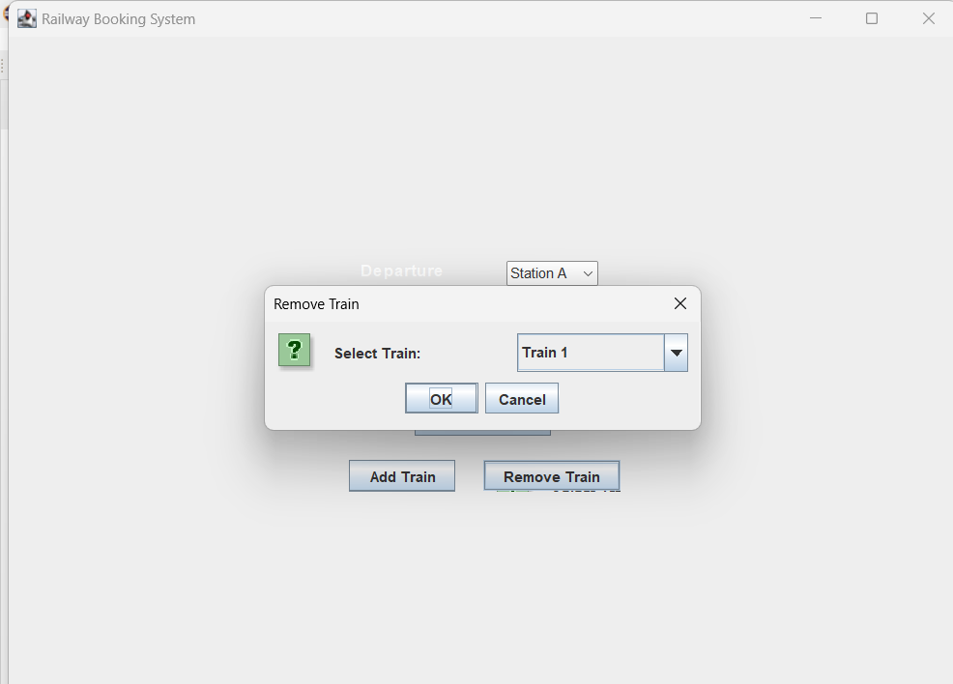
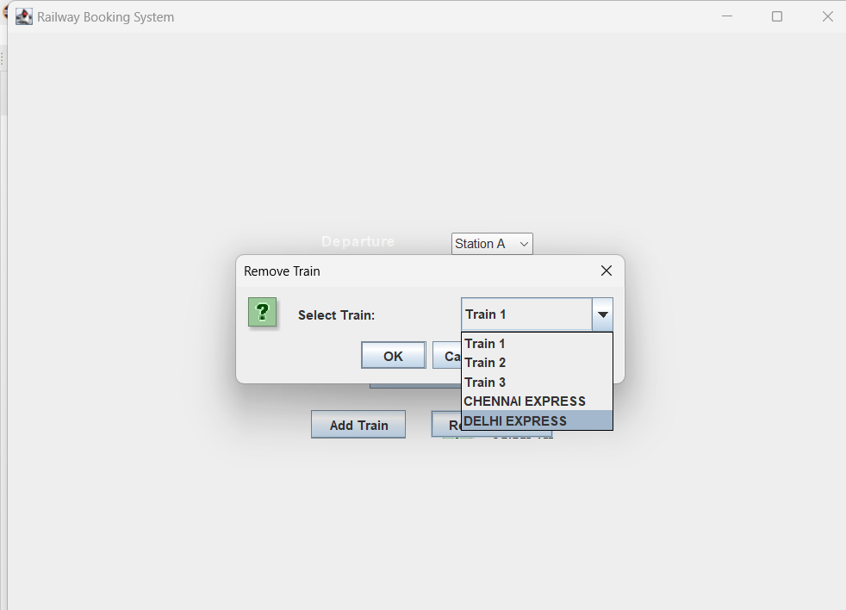

Slide 11
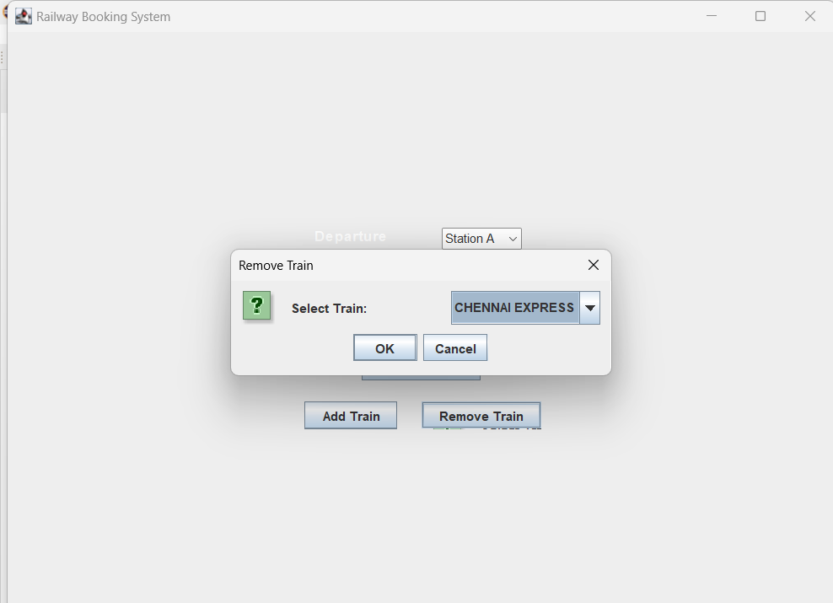
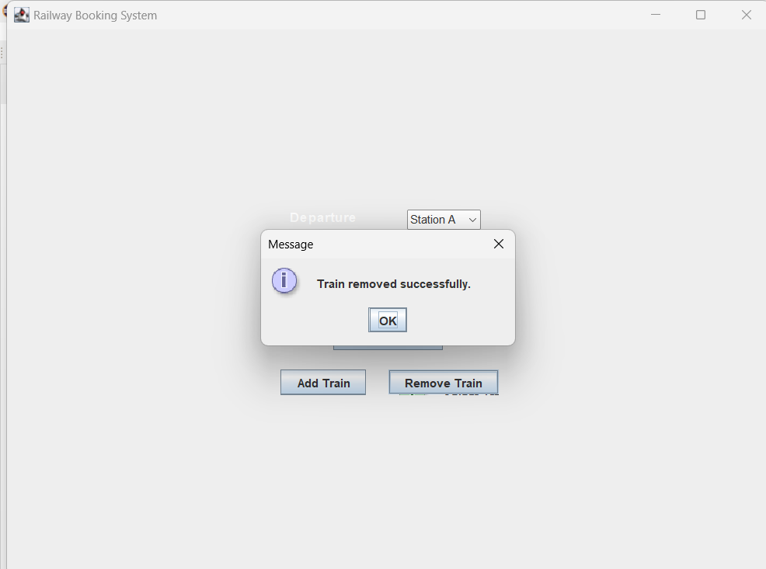

Slide 12
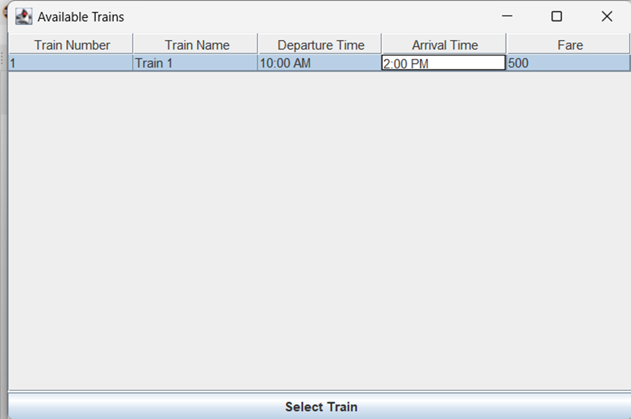
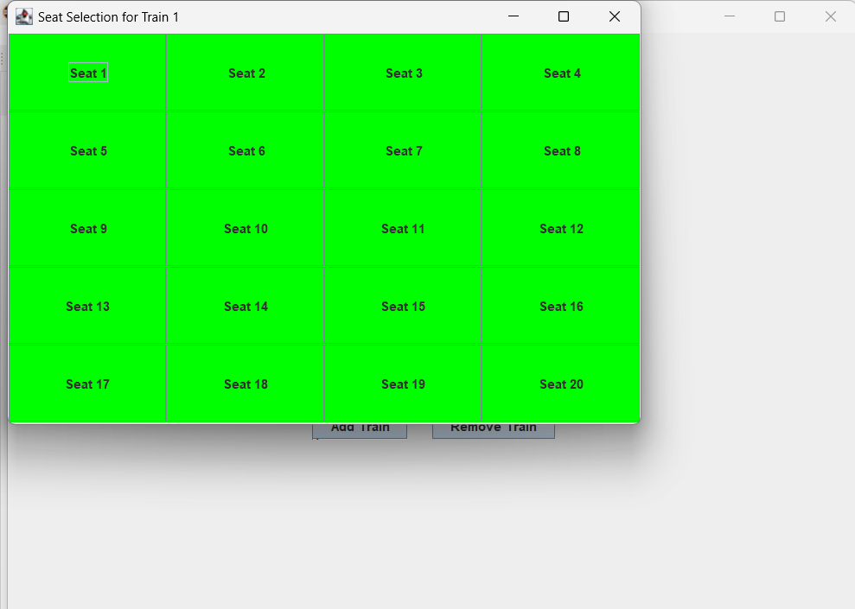

Slide 13
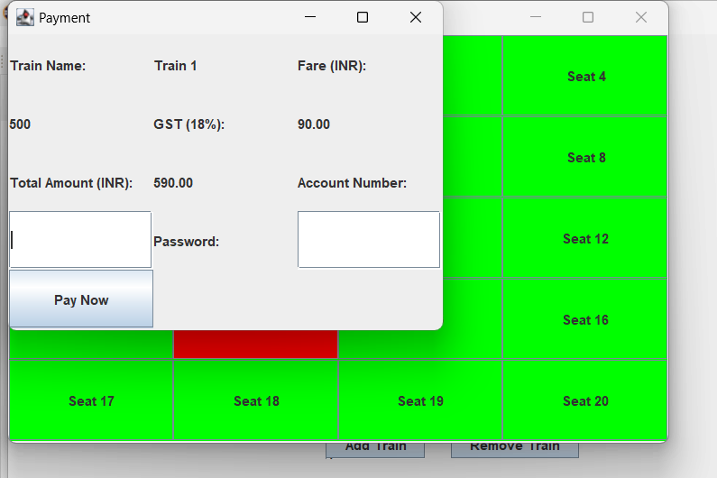
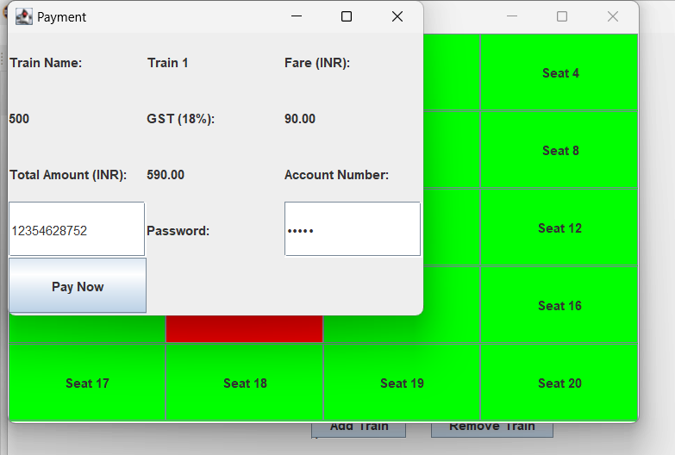

Slide 14
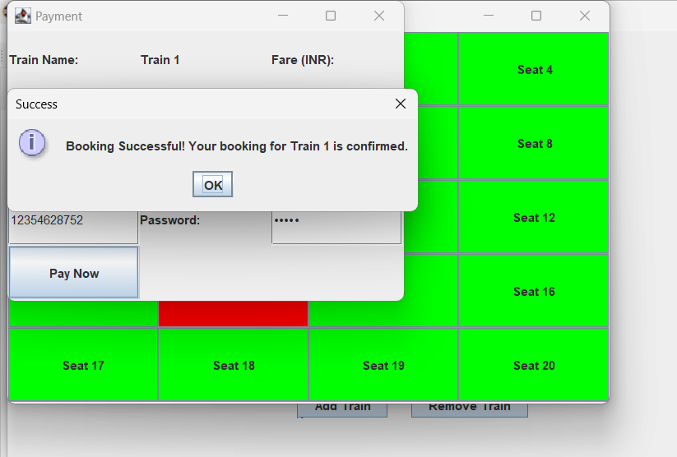

Slide 15
Thank you!

